Slide 1
Tigers in Tech
Intro
What's not a database
What is a database
Normalization
Dimensional design
Q&A

Slide 2
Intro

Slide 3

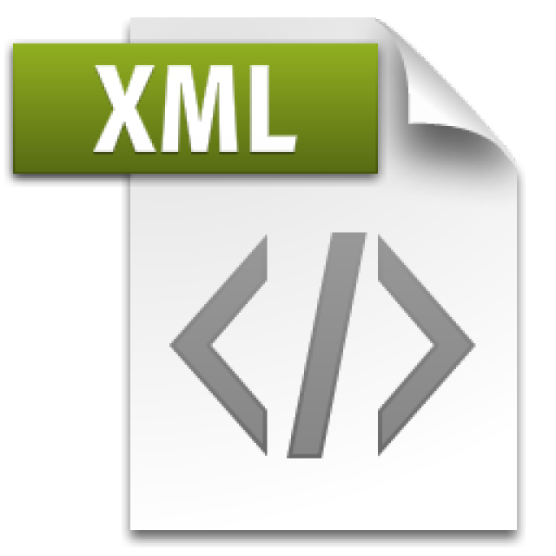

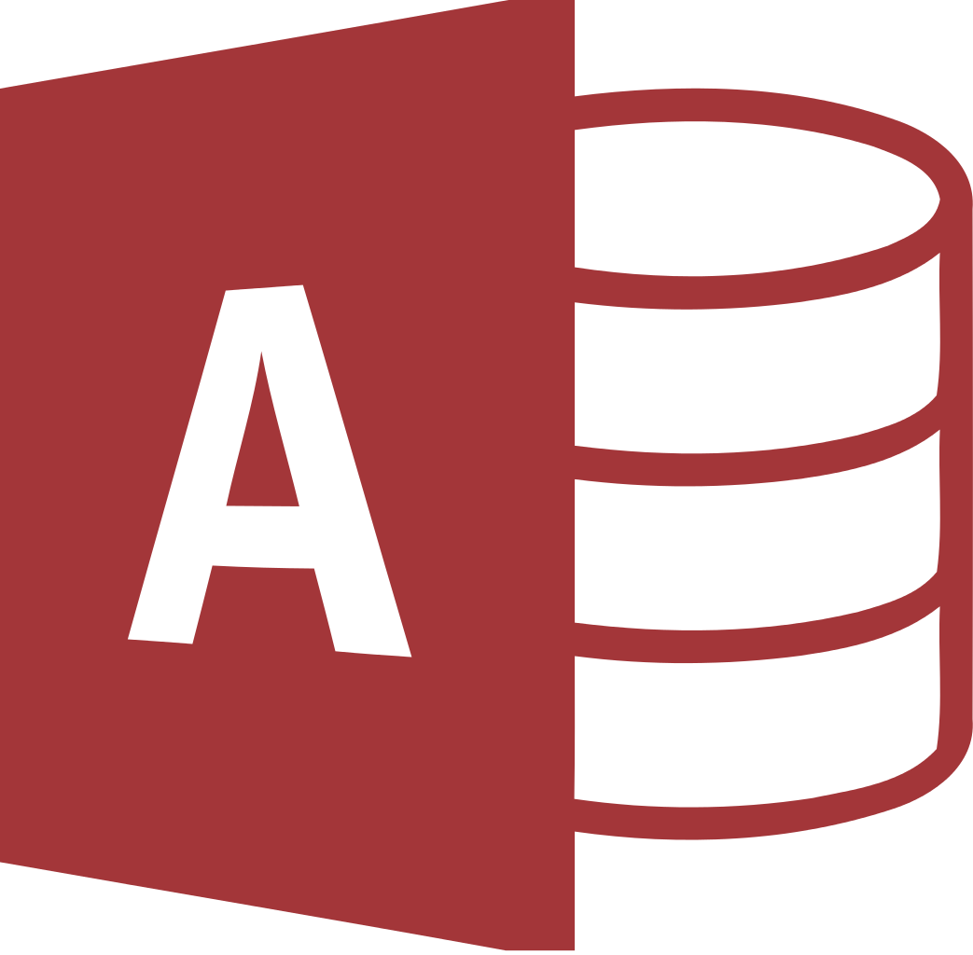
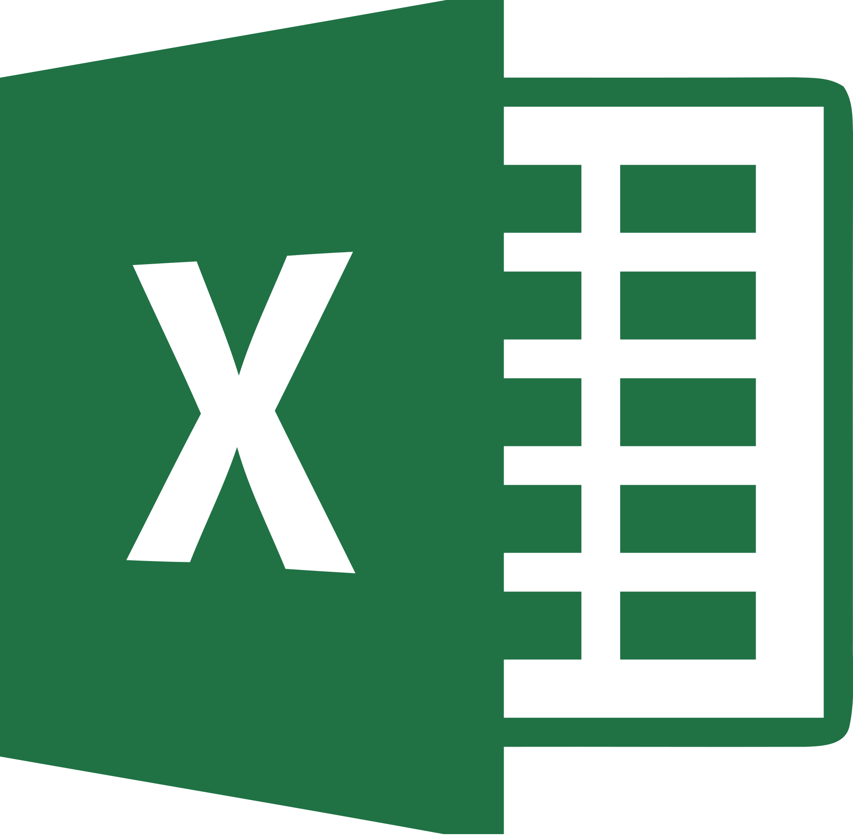
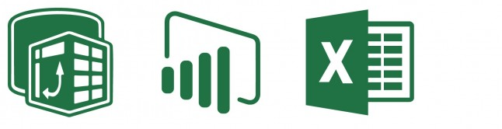
What’s Not a Database
Flat files
Including json and xml
Azure Table storage
Microsoft Access databases
Not designed for Concurrency
Excel - most popular BI tool in the world
There are dangers of "silo'ing" data
The Excel + PowerPivot + PowerBI stack
Though, valuable tools for self-service business intelligence
But not a database!

Slide 4
What’s Not a Database
Things that are NOT databases may do just fine for:
Store data for retrieval, even querying, by a user
Have data appended
Maybe even have some optional structure around data types
Things that are NOT databases are not designed for:
Strongly-typed data validation
Transactional processing, isolated updates
Disaster Recovery / High Availability
Concurrency (multiple users)
Corruption Detection
Much more…

Slide 5
MS Access is a “Database Simulator”
Microsoft Access documentation is full of caveats about the lack of concurrency and scalability for Access.
The 32-bit "Microsoft Jet [the database engine inside Access] can only handle a limited number of sessions."
"...when multiple concurrent users make requests of a Microsoft Access database, unpredictable results may occur."
"...it was not intended (or architected) for high-stress performance..."

Slide 6
What is a Database
Products like Microsoft SQL Server (and Azure SQL DB)
Competitors: Oracle, MySQL, PostgreSQL, IBM DB2, SQLite
All follow some implementation of a universally accepted standard language for data platforms:
SQL – “Structured Query Language”
SELECT … FROM … WHERE …
Microsoft’s implementation = TSQL
Oracles implementation = PLSQL
Basics are same, but many important vendor-specific features are nonstandard, not interchangeable, require cross-training

Slide 7
SQL
“Structured Query Language”
“Sequel” not “Ess Que Ell”
“SQL Server” is the name specifically for the Microsoft database platform

Slide 8
A.C.I.D. Compliant Databases
Atomic
A transaction is all or nothing
Rollbacks and commits must be complete
Consistent
Transaction brings the entire database from one state to another - not just a single part of the database
Eventual consistency can be useful - Cassandra, MongoDB, Redis

Slide 9
A.CI.D. Compliant Databases
Isolated
Transactions, though handled concurrently, are still processed sequentially and independently
Incomplete transactions should not be visible to other transactions
Durable
If the power goes off, the data is still there. It's not stored in volatile memory. It must be “hardened” to disk, and so must be away of the inherent performance issues with IO.

Slide 10
NoSQL
NoSQL isn’t a product, it’s a category, similar to “Big data”
Big data storage: Apache Hadoop, Azure Blob Storage, Spark
NoSQL platform examples: RavenDB, MongoDB, Amazon DynamoDB.
Amazon, Facebook, Google have their own platforms
There are vendors who have specialized in it all along
Twitter originally used Cassandra, now they use their own “Twitter-scale” distributed database platform, Manhattan

Slide 11
NoSQL
One of the characteristics (and common use cases) of a NoSQL database is eventual consistency.
Twitter cannot commit a transaction globally, synchronously
Your hot taek tweet takes some time to propagate globally through the distributed database system
Other aspects of ACID may be violated in name of performance, and as long as the devs are aware, it’s OK.
This would be completely unacceptable for:
A stock exchange (NASDAQ – runs on MS SQL Server)
A sportsbook (Bwin – runs on MS SQL Server)

Slide 12
NoSQL
Microsoft isn’t without NoSQL offerings:
PolyBase is a feature inside MS SQL to query big data in Hadoop or Azure Blob storage with TSQL
Many different MS SQL features that break ACID
CosmosDB –new planet-scale database platform

Slide 13
Aside on PaaS
MS SQL Server is installed, configured, maintained
What if there was an offering that provided everything for you, automated, without maint?
Platform-as-a-Service
An instance of a database is created for you, with easy UI to interact, no maintenance, backups, storage config needed
Scalable – change CPU/memory/storage capacity on the fly
Examples: Azure SQL DB, Amazon RDS
Infrastructure-as-a-Service
Here’s a VM. Have fun. But you don’t have to worry about the network layer, redundant power, physical disks. Also scalable.

Slide 14
Flatten Tables vs Normalized Tables
Flattened
To express 1-to-Many relationships, must grow horizontally by adding columns
(example: Phone1, Phone2…)
No good for transactions, can be useful for reporting
Difficult to add type attributes (will demonstrate)
Normalized
Reduces duplicate data
Helps identify relationships between data
Allows for 1-to-Many relationships by adding rows

Slide 15
Normalized Table Design
Normal Forms
3NF (Third Normal Form) is most common
There is no two.
Important to understand:
Primary Key
Unique Key
Foreign Key
Natural Key
Surrogate Key

Slide 16
Keys
Primary Key
Identify parent relationships to other tables
Unique Key
Identify uniqueness(es), can have more than one
Foreign Key
Identify this column as a child to another table
Natural Key
Business-generated key
Surrogate Key
System-generated key

Slide 17
Keys
Primary Key
Identify parent relationships to other tables
Unique Key
Identify uniqueness(es), can have more than one
Foreign Key
Identify this column as a child to another table
Natural Key
Business-generated key
Surrogate Key
System-generated key
Often these keys are on the same column, when we create an IDENTITY column.
Also commonly serves as the Key to clustered index.

Slide 18
Keys
Primary Key
Identify parent relationships to other tables
Unique Key
Identify uniqueness(es), can have more than one
Foreign Key
Identify this column as a child to another table
Natural Key
Business-generated key
Surrogate Key
System-generated key
These two MUST NOT be the same!
Users should never see Surrogate Keys, and Surrogate Keys should never change.
Users should only see Natural keys, and can therefore change these values.

Slide 19
Keys
Primary Key
Identify parent relationships to other tables
Unique Key
Identify uniqueness(es), can have more than one
Foreign Key
Identify this column as a child to another table
Natural Key
Business-generated key
Surrogate Key
System-generated key
Primary Keys are always unique, but you can have more than one Unique Key. You can have a Primary Key on an IDENTITY field, and also enforce uniqueness on one or more other columns.

Slide 20
Keys
Primary Key
Identify parent relationships to other tables
Unique Key
Identify uniqueness(es), can have more than one
Foreign Key
Identify this column as a child to another table
Natural Key
Business-generated key
Surrogate Key
System-generated key
Foreign Keys reference the Primary Key of another table.
Surrogate Keys are the best choice for PK and FK’s, because they can never change.

Slide 21
Normalization Antipatterns
Bad (one table)
Student
NAME(key)_PHONE1_PHONE2_PHONE3_PHONE4…
Good (three tables):
Student
ID(key)_NAME
StudentPhone
ID(key)_StudentID_PhoneNum_PhoneTypeID
PhoneType
ID(key)_TYPE

Slide 22
Normalization Antipatterns
Bad (one table)
Student
NAME(key)_PHONE1_PHONE2_PHONE3_PHONE4…
B Smith 2255555555 2254444444 2253333333 NULL
J Smith 2255555555 2254444444 NULL NULL
K Smith 2255555555 2254444444 2251111111 2259999999
Good (three tables): Student
ID(key)_Name
StudentPhone 1 B Smith
ID(key)_StudentID_PhoneNum_PhoneTypeID 2 J Smith
1 1 2255555555 1 3 K Smith
2 1 2254444444 1
3 1 2253333333 2 PhoneType
4 2 2255555555 1 ID(key)_Type
5 2 2254444444 2 1 Mobile
3 2255555555 1 2 Home
….

Slide 23
Dimensional Design
Normalized – heavy read/write
Dimensional – heavy read
Normalized – source of the data as it changed
Dimensional – source of reporting, analysis
Kimball – a design pattern by Ralph Kimball, common industry standard for “star schema” design.

Slide 24
Dimensional Design
Dimensions and Attributes
FactEnrollment
DimStudentID
DimGenderID
DimHighSchoolID
DimHomeStateID
DimClassID
DimDateID
DimAnticipatedGradDateID …
Count
GPA
CreditHoursEarned
CountW
Measures Fact Keys
DimStudent
ID
Name
DOB
HomeAddres…
DimGender
ID
Name
DimHighSchool
ID
Name
Address…
DimClassID
ID
Name
Description
Code
DimHomeStateID
ID
Abbrev
Name
DimDate
ID (isoDate YYYYMMDD)
DayofWeek
DayofMonth
Month
MonthName
Year
DayofYear
WeekofYear
ISOWeekofYear
Quarter
FiscalWeek
FiscalQuarter
FiscalYear

Slide 25
Dimensional Design (Logical)
DimStudent
DimClass
DimHomeState
DimGender
FactEnrollment
DimSnapshotDate
DimRoom
DimAnticipatedGraduationDate
DimSemester
DimHighSchool

Slide 26
Normalized Design (Logical)
Room
Gender
ClassRoom
Class
StudentClass
Student
AnticipatedGraduationDate
ClassSemester
HighSchool
SnapshotDate
Semester
HomeState
FactEnrollment

Slide 27
ETL and ELT
ETL: Extract, Transform, Load
Regularly Pull data, scrub it, merge it into the DW
Microsoft Integration Services (SSIS) is an industry- standard ETL tool
ELT: Extract, Load, Transform
Newer “Data Lake” approach
Data comes in too fast (think IoT applications)
Load it into “Data Lake”, scrub upon consumption

Slide 28
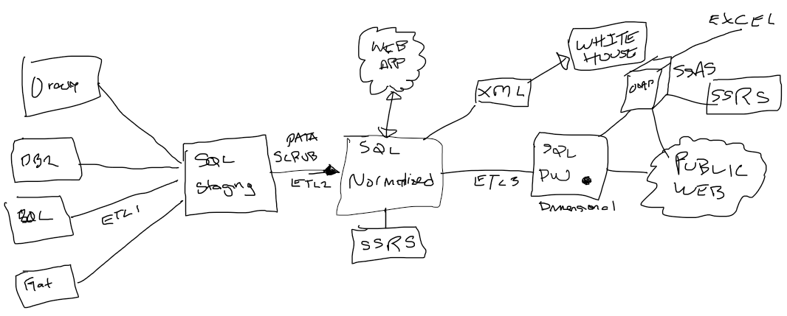
Whiteboard

Slide 29

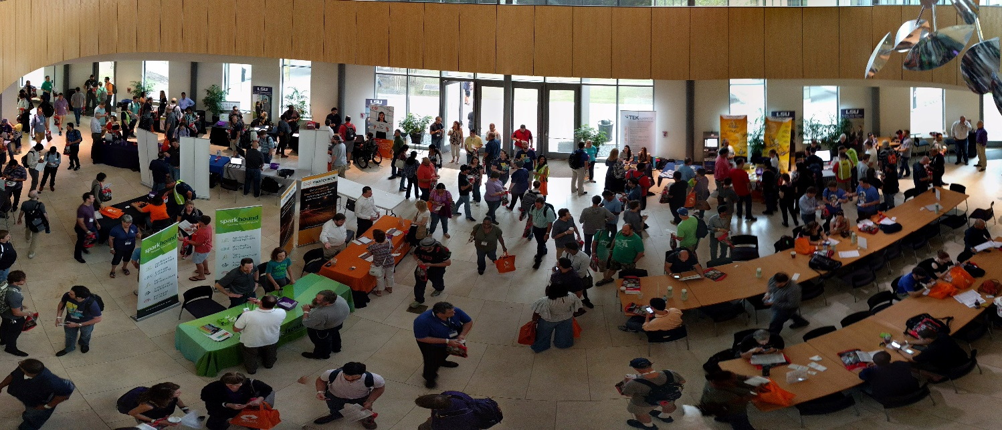
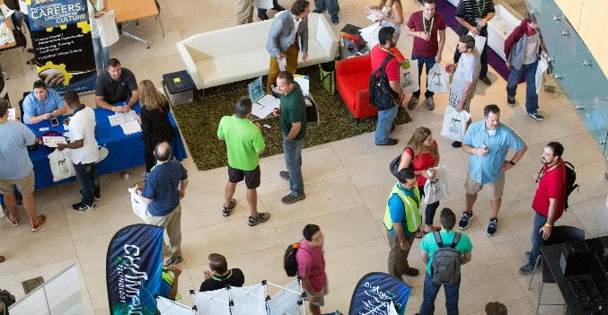
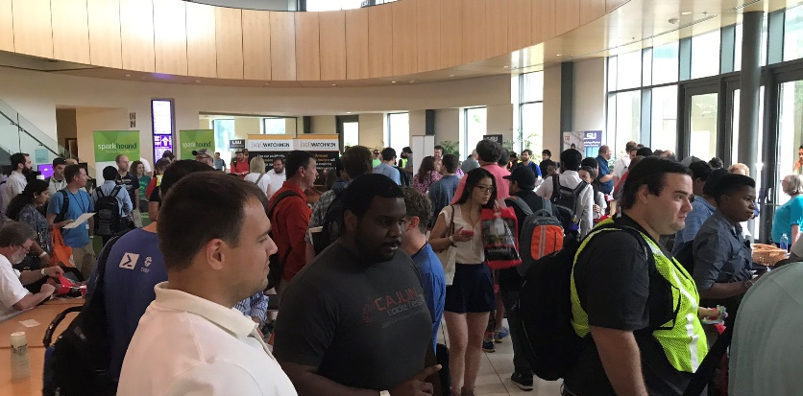
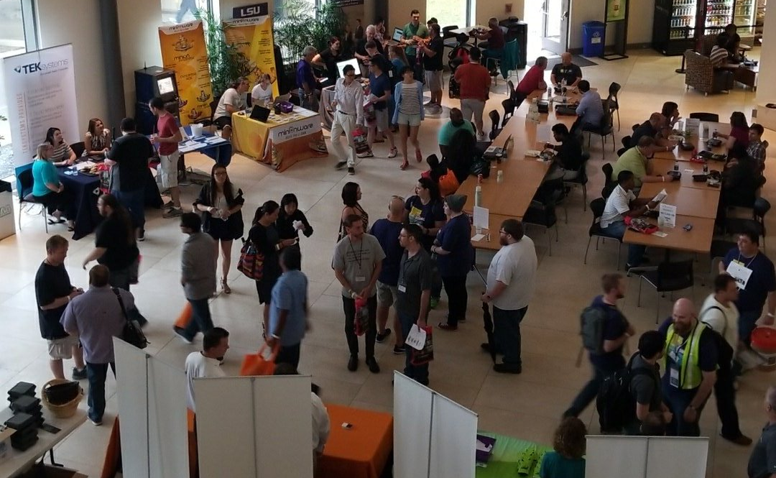
Free SQL Server, .NET, Business Intelligence training and more
in the LSU BEC!
An all day FREE training event with SQL Server and Development related sessions spread out over multiple tracks of Business Intelligence, SQL Development,
Database Administration, IT Pro, .NET,
Career Development, and CIO/IT Management
See you August 11 at
SQLSatBR.com

Slide 30
Local community
SQLSaturday.org
PASS.org
BatonRouge.slack.com – #events and others
BatonRougeAnalytics.slack.com – introduce yourself on #general
BRSSUG.org – monthly meetings
BRDNUG.org – monthly meetings

Slide 31
Bio and contact
William D Assaf, MCSE
Principal Consultant, Manager – DBA Team at
Sparkhound Inc. in Baton Rouge
William.Assaf@sparkhound.com
Twitter: @william_a_dba
This presentation, including all source code and this slide deck, has been posted at my blog:
SQLTact.com

